Slide 1
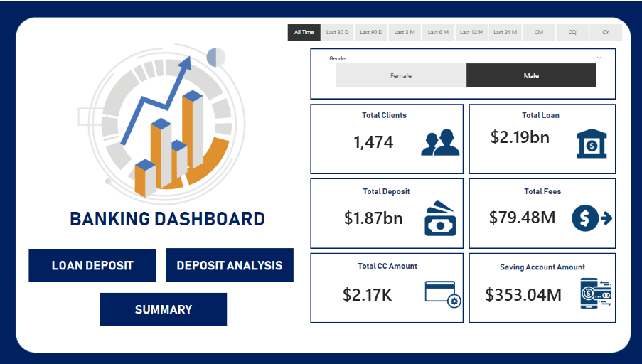
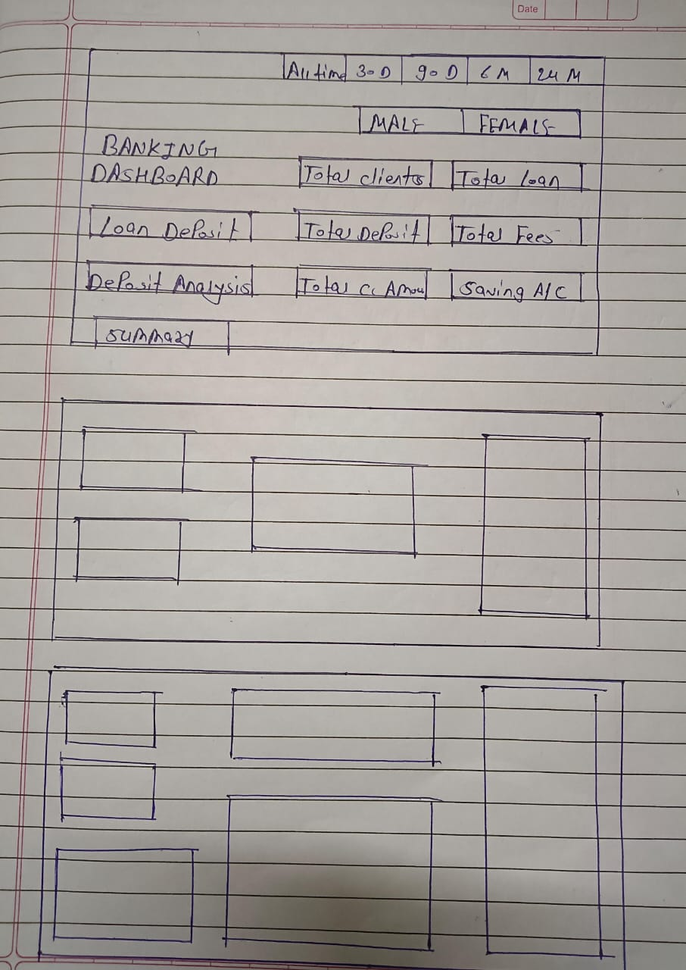
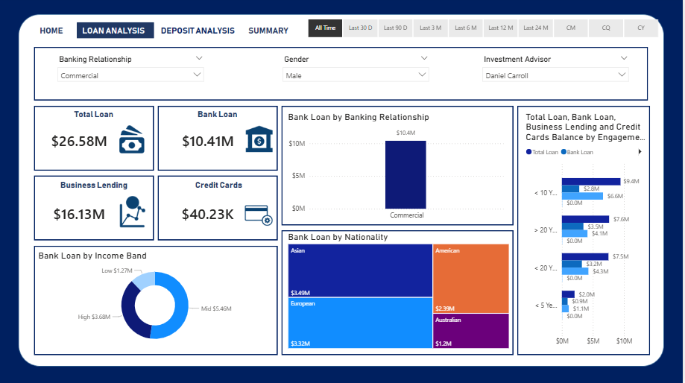
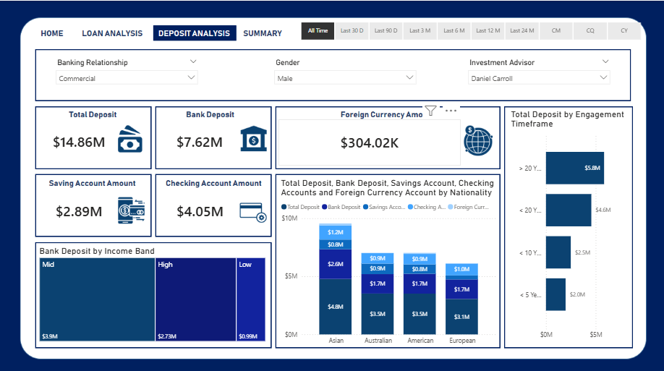
HOME INTERFACE
"How was my approach to creating dashboards?"
Roughed Report In a Page
LOAN ANALYSIS
DEPOSIT ANALYSIS

